Slide 1
Metals

Slide 2
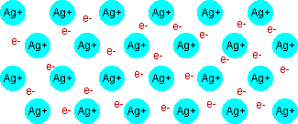
Metallic bonding
a 3-d lattice of metal ions in a ‘sea’ of delocalised valence electrons
Strong bonds

Slide 3
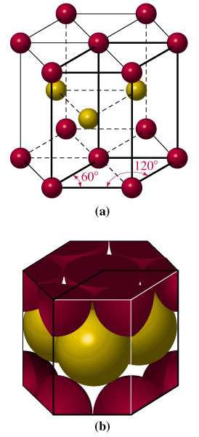
Atomic arrangement in Gold showing regular lattice Regular packing means crystals can form

Slide 4
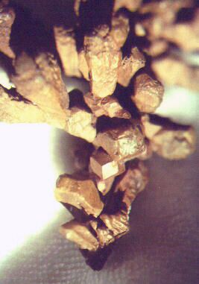
Native
Copper
crystals
The regular external nature of crystals reflects the regular arrangement of the atoms in the internal metallic lattice.

Slide 5
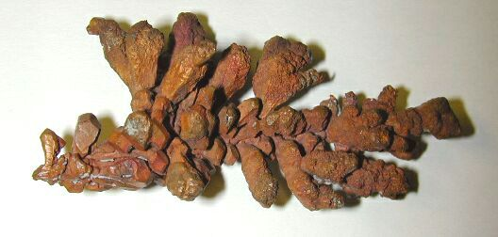
Native
Copper
crystals

Slide 6
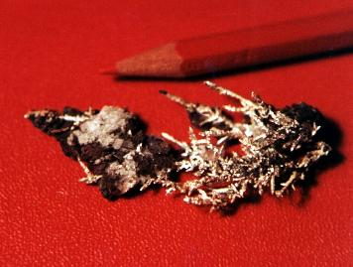
Silver crystals - michigan

Slide 7
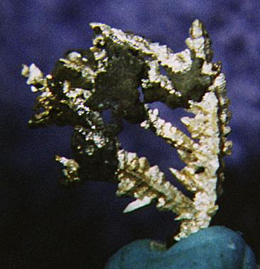
Silver CRYSTALS- Michigan

Slide 8
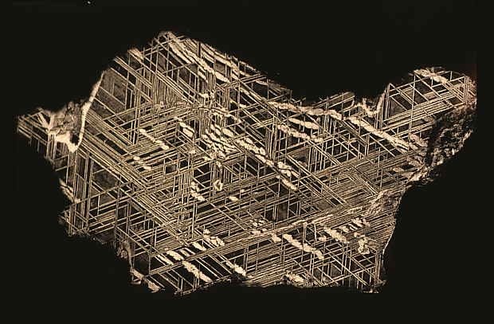
Iron meteorite – showing intergrowth of fe-Ni alloys
Iron meteorite

Slide 9
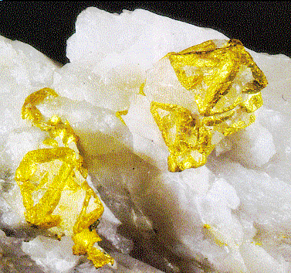
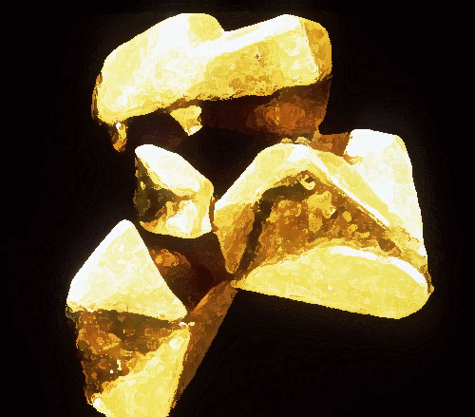
Gold S.Africa California

Slide 10
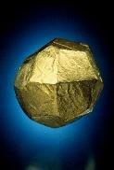
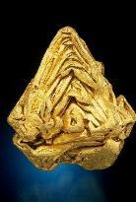
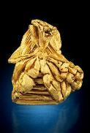
Venezuelan Gold Crystals
World's Largest Single Gold Crystal (non-wire)
PRICE REDUCED TO $825,000.
"
A truly " shining Trapezohedron
PRICE REDUCED TO $600,000.
PRICE REDUCED TO $300,000.

Slide 11
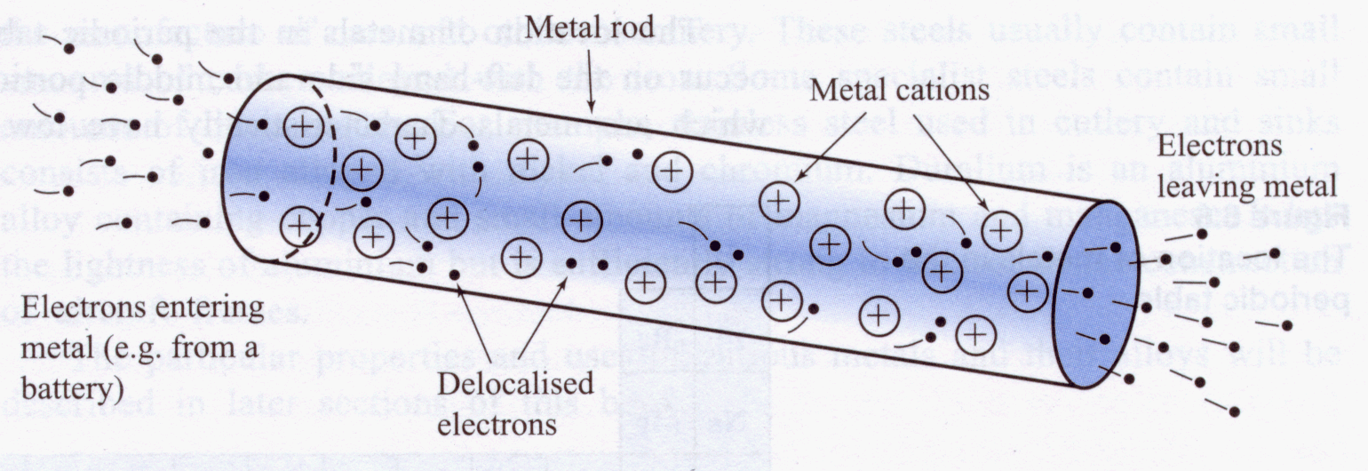
Why do metals conduct electricity?
The delocalised valence (outer) electrons are free to move between the positive metal ions which are fixed in the lattice arrangement.

Slide 12
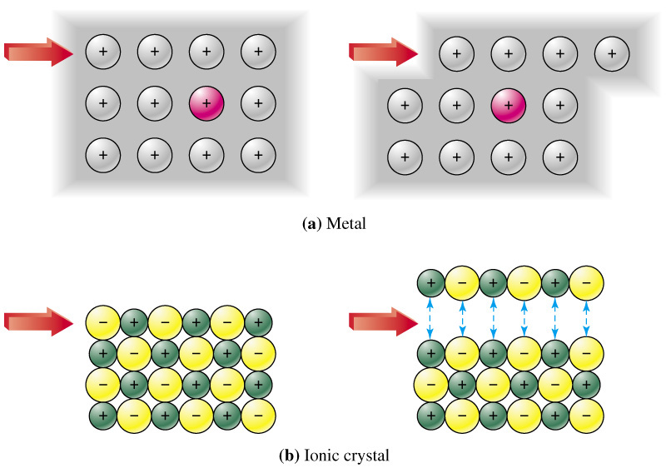
Why are metals ductile & malleable?
Unlike ionic solids, if the metal ions slide across each other, they will still be separated by opposite charges – the delocalised valence electrons.

Slide 13
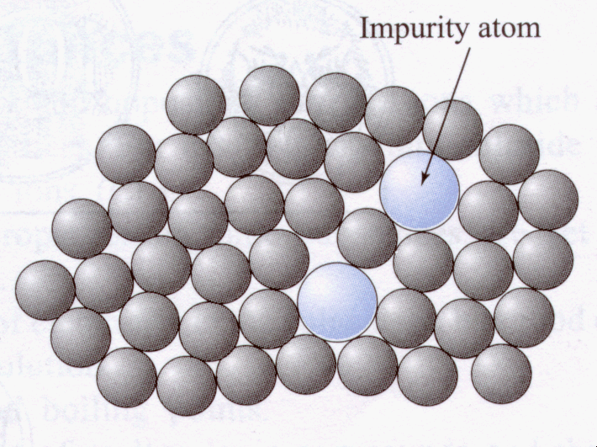
Hardness can be increased by alloying
This is mainly due to the impurity atoms interupting the orderly arrangement of the metal atoms (ions) in the lattice making it harder for them to slide past one another.

Slide 14
Fe
C
Eg. Steel – an alloy of iron & carbon is harder than pure iron.

Slide 15
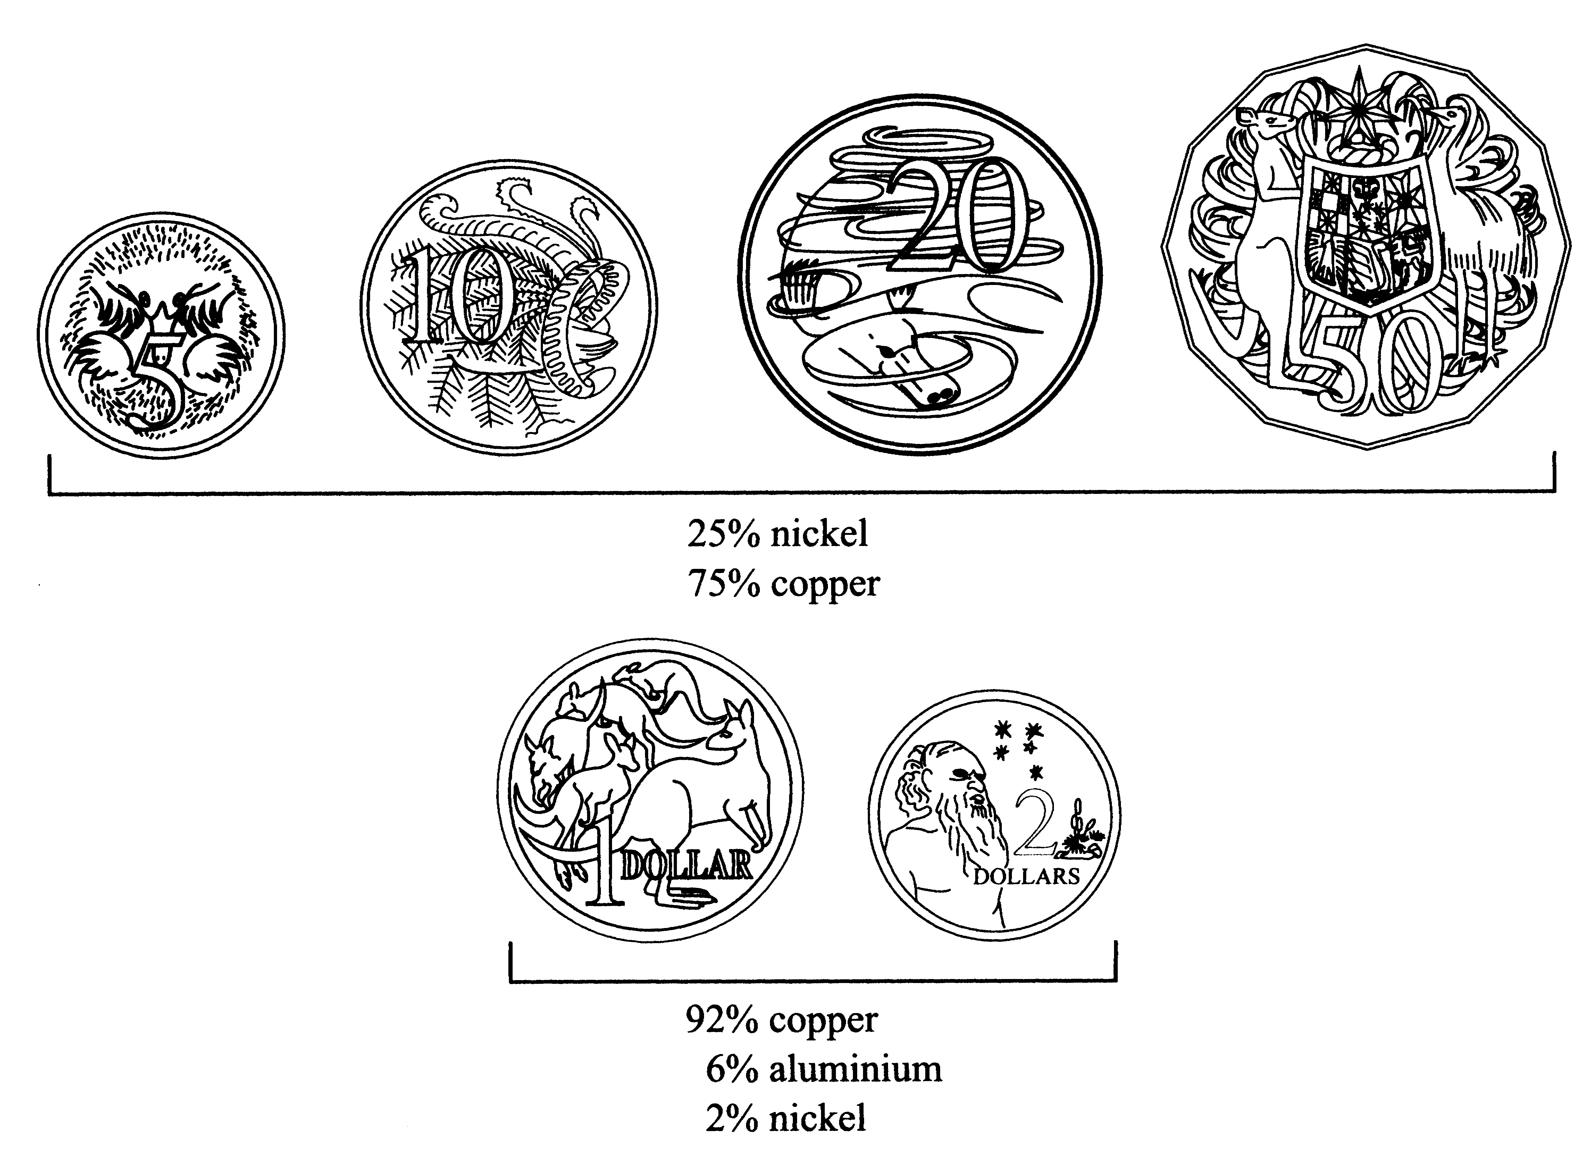
Australian coins are an example of the use of alloys

